Slide 1
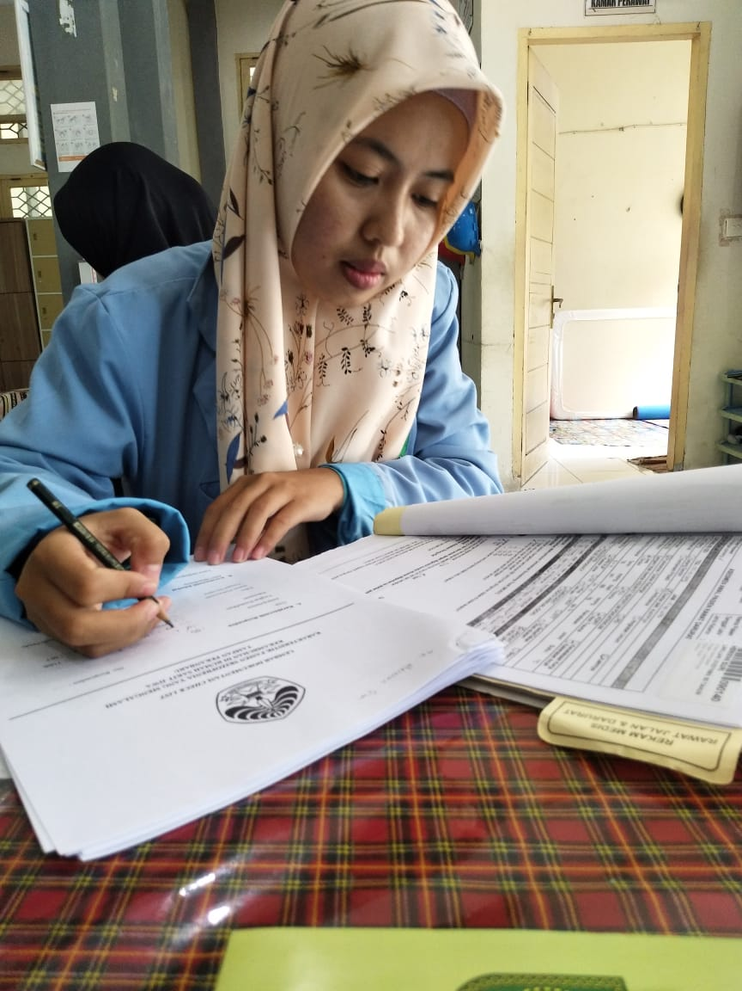
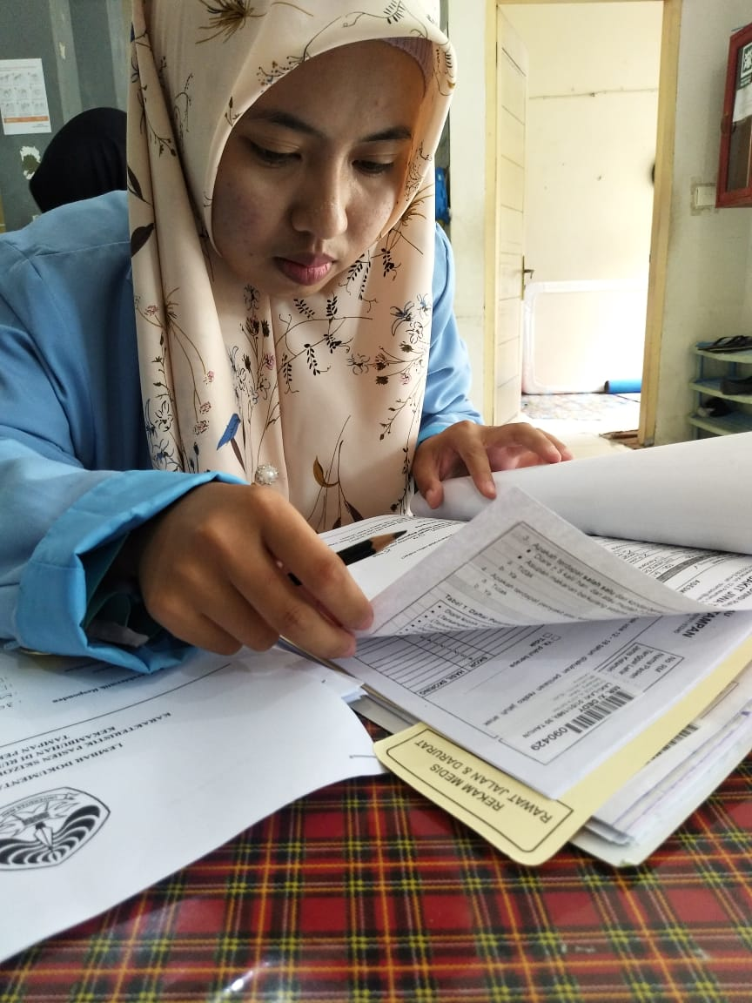
HASIL PENELITIAN
Research Documentation
Secondary data retrieval (medical record)

Slide 2
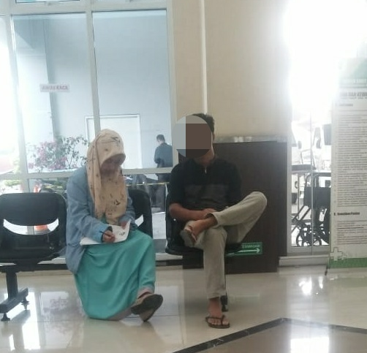
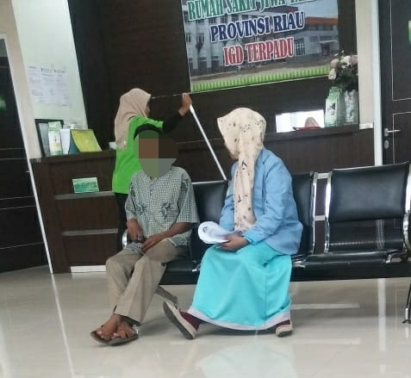
HASIL PENELITIAN
Research Documentation
Secondary data retrieval (family of patient)

Slide 3
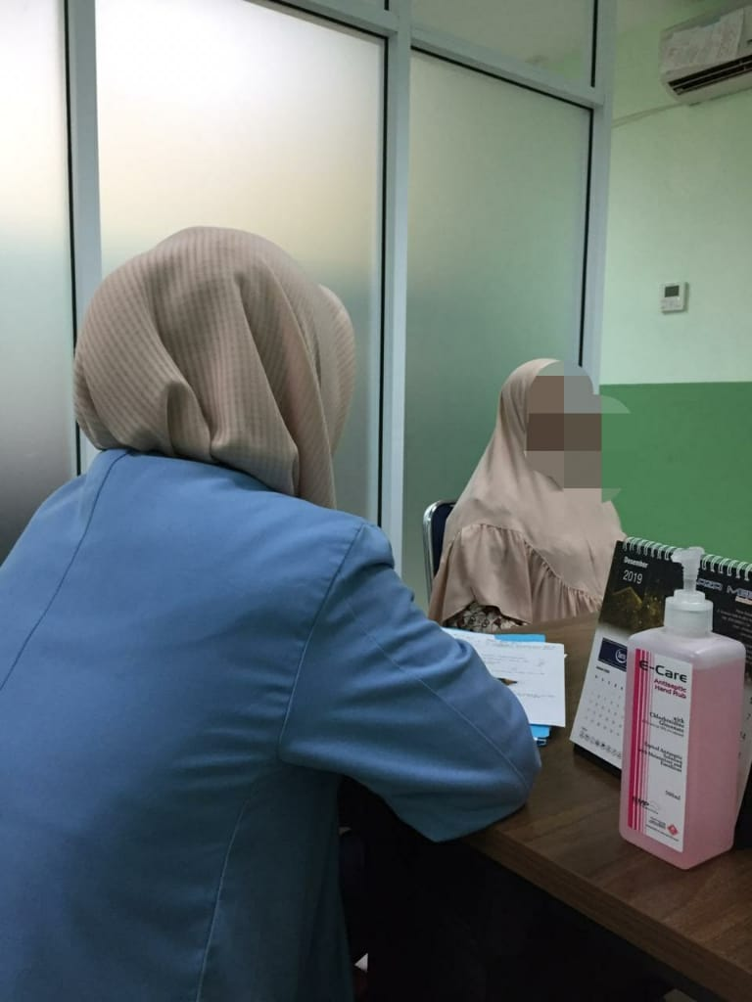
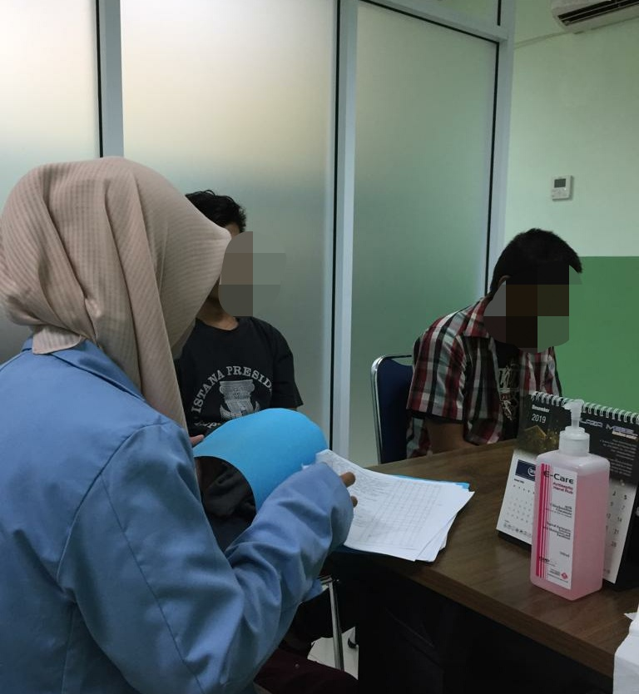
HASIL PENELITIAN
Research Documentation
Secondary data retrieval (family of patient)

Slide 4
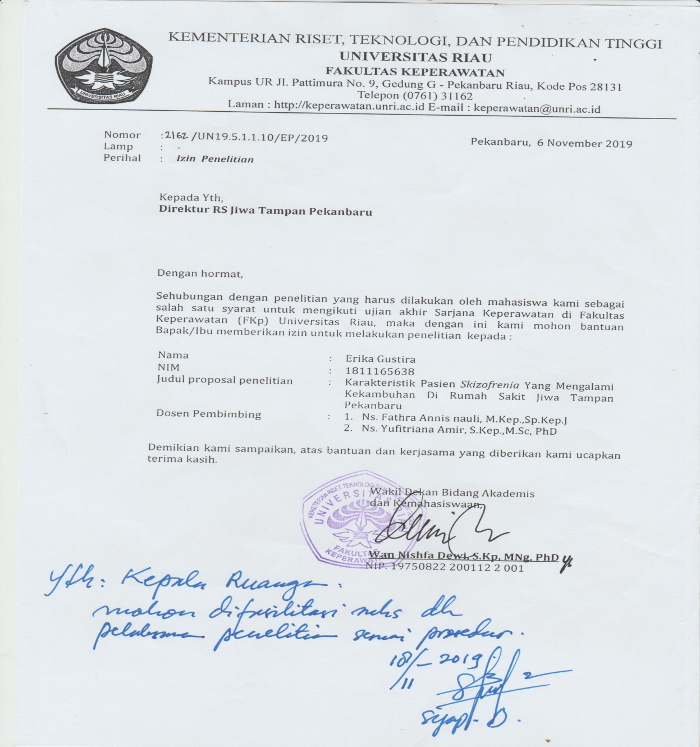
HASIL PENELITIAN
Research Consent

Slide 5
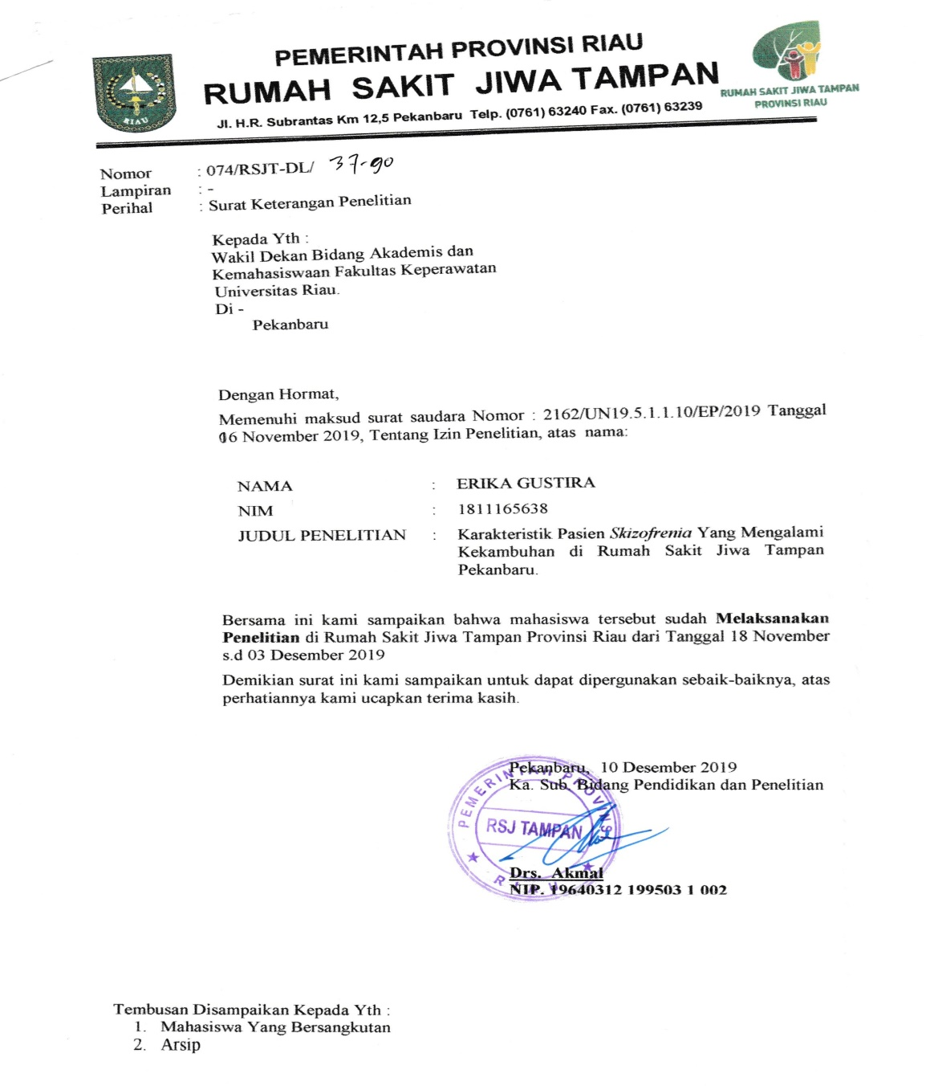
HASIL PENELITIAN
Research Consent

